Slide 1
Magnolia Flash Sessions
Session 3: Mississippi Digital Library

Slide 2
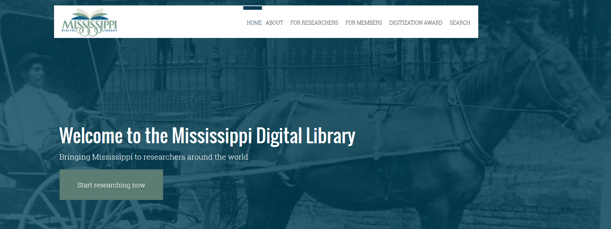
Mississippi digital library
The cooperative digital library program for the state. Its ultimate aim is to provide access to primary source materials covering a wide range of subject areas from Mississippi museums, archives, libraries, and historical societies.

Slide 3
About the Mississippi digital library
Hosted by USM in Hattiesburg.
Board made up of advisors from partnering entities in Mississippi.
Goal for researchers is to provide open access to digital collections in the state and to make them as findable and usable as possible.
Goal for partners is to emphasize “collection building and discoverability.”
There are 30 partnering institutions; 9 are public libraries.
MLC is working to put 3300 historical photographs into the MDL.

Slide 4
Materials included in the MDL
Books
Articles
Journals
Images
Audiovisual

Slide 5
Use of the MDL
For research, presentations, or educational purposes:
For commercial use or publications:
Materials are free to use
Must give citations for what is used.
If you’re unsure of how to cite materials, contact MDL, who will help you.
The partnering institution must consent to your use of its materials.
To get this consent, contact MDL, and they will connect you with the partner.
Partners establish copyright for their materials. If you’re unsure if a material is copyrighted, contact MDL.

Slide 6
Searching
Basic Search
Advanced SeaRch
Once you enter in your search terms, you can further refine your results on the right-hand side of your screen, by:
Contributing Institution
Collection
Format
Creation Date.
There are suggested new searches from the results list.
Author/Creator of your current item
Same subject
You have the limiting options all on one screen.
You can search in two fields.

Slide 7
Options once you’ve selected a record
Images
Download image
Printing
Text
Text/text search
Different views
Metadata
Further information about the collection
Landing page
Recent additions

Slide 8
Questions?
Joy Garretson
Library Development Director
Mississippi Library Commission
601-432-4498
jgarretson@mlc.lib.ms.us
Lucinda Ogden
Continuing Education Coordinator
Mississippi Library Commission
601-432-4057
logden@mlc.lib.ms.us
Mississippi Digital Library Staff:
contact@msdiglib.org
601-266 -6864

